Slide 1
Foretelling His Passion
Lesson 18
Matthew 20:17-19; Mark 10:32-34; Luke 18:31-34
April 13, 2022

Slide 2
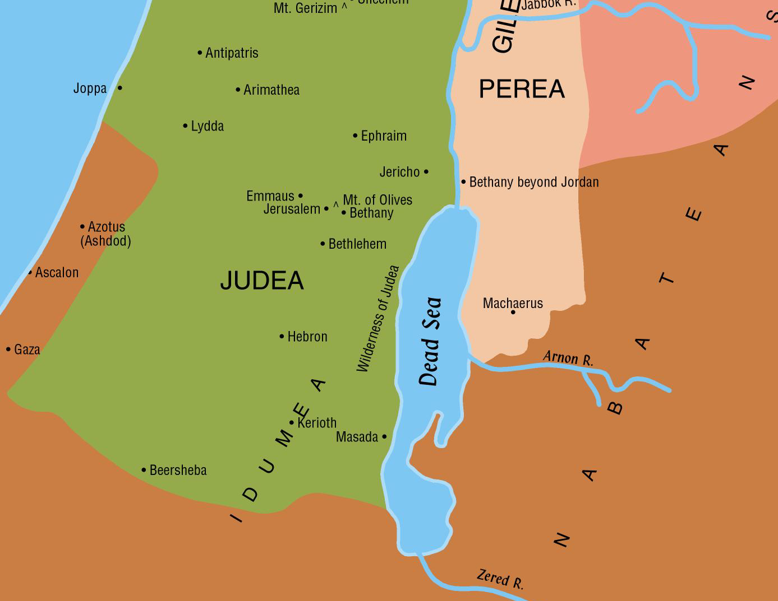

Foretelling His Passion
Matthew 20:17-19, “And as Jesus was going up to Jerusalem, he took the twelve disciples apart, and on the way he said unto them, Behold, we go up to Jerusalem; and the Son of man shall be delivered unto the chief priests and scribes; and they shall condemn him to death, and shall deliver him unto the Gentiles to mock, and to scourge, and to crucify: and the third day he shall be raised up.”
That is to the Passover. This journey was from the east side of Jordan (Matthew 19:1). At this time he was on this journey to Jerusalem, probably not far from Jericho. This was his last journey to Jerusalem. He was going up to die for the sins of the world. (Barnes’ Notes)

Slide 3
Foretelling His Passion
Matthew 20:17-19, “And as Jesus was going up to Jerusalem, he took the twelve disciples apart, and on the way he said unto them, Behold, we go up to Jerusalem; and the Son of man shall be delivered unto the chief priests and scribes; and they shall condemn him to death, and shall deliver him unto the Gentiles to mock, and to scourge, and to crucify: and the third day he shall be raised up.”
“All the males of the Jews were required to be at this feast (Ex 23:17). The roads, therefore, on such occasions, would probably be thronged. It is probable, also, that they would travel in companies, or that whole neighborhoods would go together. See Luke 2:44. By his taking them apart is meant his taking them aside from the company. He had something to communicate which he did not wish the others to hear. Mark 10:32 adds: ‘And Jesus went before them, and they were amazed; and as they followed they were sore afraid.’” (Barnes’ Notes)

Slide 4
Foretelling His Passion
Matthew 20:17-19, “And as Jesus was going up to Jerusalem, he took the twelve disciples apart, and on the way he said unto them, Behold, we go up to Jerusalem; and the Son of man shall be delivered unto the chief priests and scribes; and they shall condemn him to death, and shall deliver him unto the Gentiles to mock, and to scourge, and to crucify: and the third day he shall be raised up.”
For a third time Jesus tells His disciples what was going to happen to Him in Jerusalem (Matthew 16:21-23; 17:22-23;
20:17-19).
He was thus betrayed by Judas. (Matthew 26:15)
He was delivered to the chief priests and scribes. (Matthew 26:57)
He was condemned to death.
    The Jews had not power to inflict death, as that power had been taken away by the Romans; but they had the power of expressing an opinion, and of delivering Him to the Romans (Gentiles) to be put to death. This they did. (Matthew 26:66; 27:2-11, 27-30; cf. John 18:31)

Slide 5
Foretelling His Passion
Matthew 20:17-19, “And as Jesus was going up to Jerusalem, he took the twelve disciples apart, and on the way he said unto them, Behold, we go up to Jerusalem; and the Son of man shall be delivered unto the chief priests and scribes; and they shall condemn him to death, and shall deliver him unto the Gentiles to mock, and to scourge, and to crucify: and the third day he shall be raised up.”
Mark 10:34, “and they shall mock him, and shall spit upon him, and shall scourge him, and shall kill him; and after three days he shall rise again.
Luke 18:32, “For he shall be delivered up unto the Gentiles, and shall be mocked, and shamefully treated, and spit upon”

Slide 6
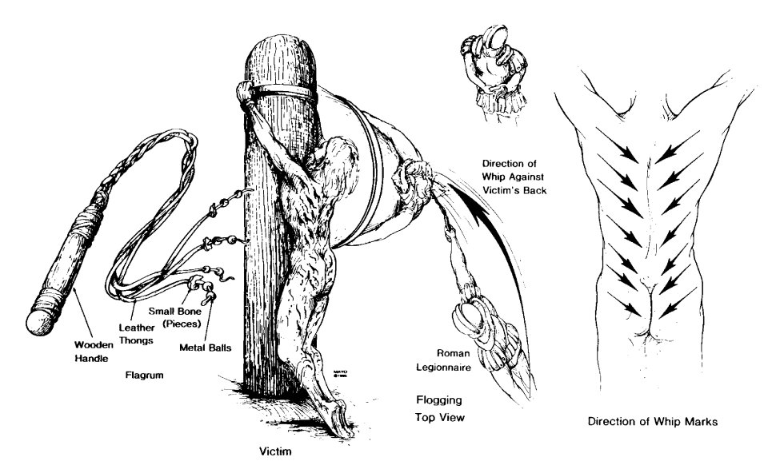

Slide 7
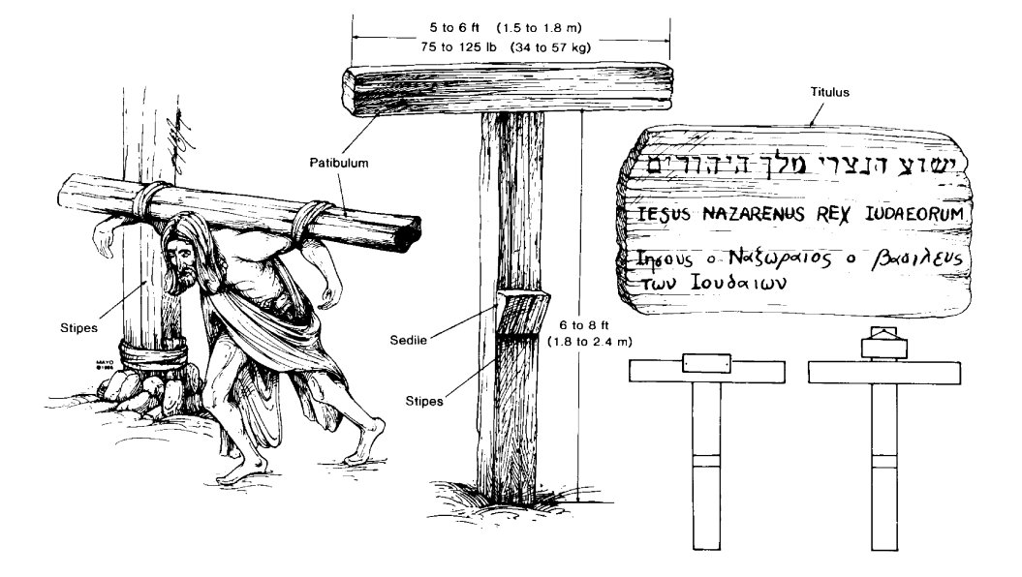

Slide 8
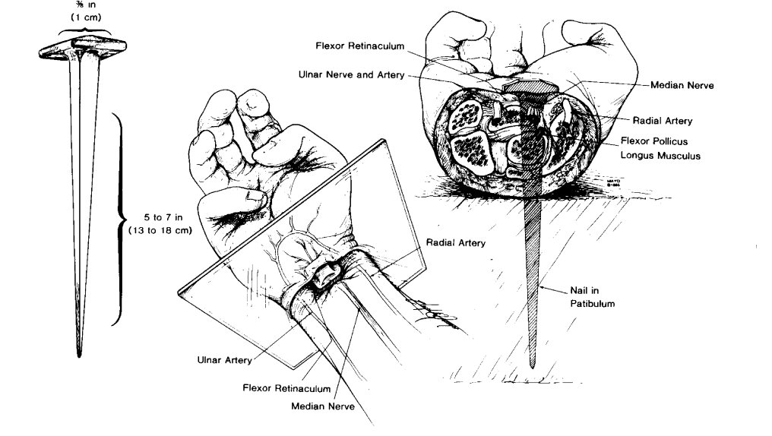
Figure 4. Nailing of wrists. Left, Size of iron nail. Center, Location of nail in wrist, between carpals and radius. Right, Cross section of wrist, at level of plane indicated at left, showing path of nail, with probable transection of median nerve and impalement of flexor pollicis longus, but without injury to major arterial trunks and without fractures of bones.

Slide 9
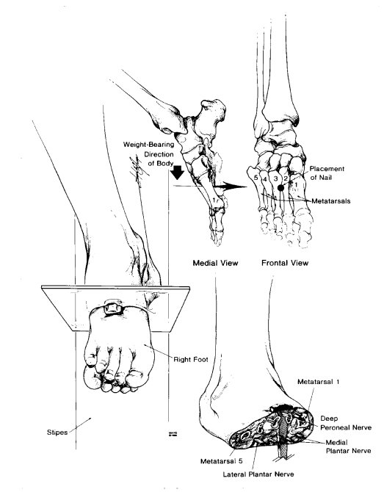
Figure 5. Nailing of feet. Left, Position of feet atop one another and against stipes. Upper right, Location of nail in second intermetatarsal space. Lower right, Cross section of foot, at plane indicated at left, showing path of nail.

Slide 10
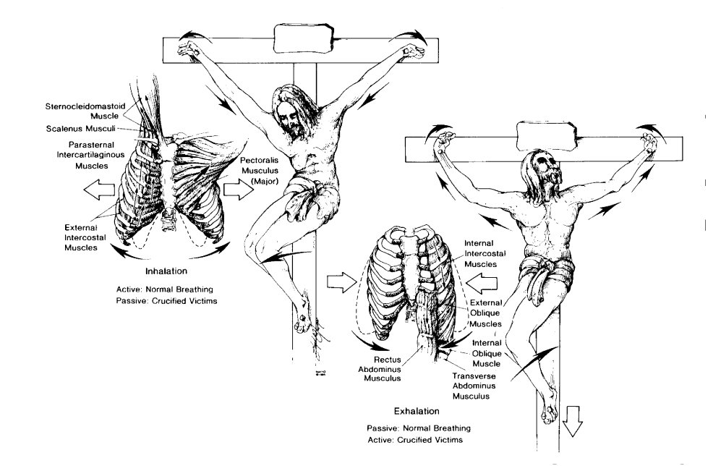
Figure 6. Respirations during crucifixion. Left, Inhalation. With elbows extended and shoulders abducted, respiratory muscles of inhalation are passively stretched and thorax is expanded. Right, Exhalation. With elbows flexed and shoulders adducted and with weight of body on nailed feet, exhalation is accomplished as active, rather than passive, process. Breaking legs below knees would place burden of exhalation on shoulder and arm muscles alone and soon would result in exhaustion asphyxia. The Crucifixion.org

Slide 11
Foretelling His Passion
Matthew 20:17-19, “And as Jesus was going up to Jerusalem, he took the twelve disciples apart, and on the way he said unto them, Behold, we go up to Jerusalem; and the Son of man shall be delivered unto the chief priests and scribes; and they shall condemn him to death, and shall deliver him unto the Gentiles to mock, and to scourge, and to crucify: and the third day he shall be raised up.”

Slide 12
Foretelling His Passion
Matthew 20:17-19, “And as Jesus was going up to Jerusalem, he took the twelve disciples apart, and on the way he said unto them, Behold, we go up to Jerusalem; and the Son of man shall be delivered unto the chief priests and scribes; and they shall condemn him to death, and shall deliver him unto the Gentiles to mock, and to scourge, and to crucify: and the third day he shall be raised up.”
Mark 10:34, “and they shall mock him, and shall spit upon him, and shall scourge him, and shall kill him; and after three days he shall rise again.”
Luke 18:32, “For he shall be delivered up unto the Gentiles, and shall be mocked, and shamefully treated, and spit upon”
Luke 18:34, “And they understood none of these things; and this saying was hid from them, and they perceived not the things that were said.” (NOTE: Peter’s previous response … Matthew 16:21-22)

Slide 13
Jesus Rebuking Ambition Of The Disciples
Lesson 18
Matthew 20:20-28; Mark 10:35-45
April 13, 2022

Slide 14
Jesus Rebukes The Disciples’ Ambition For Greatness …
Matthew 20:20-21, “Then came to him the mother of the sons of Zebedee with her sons, worshipping (him), and asking a certain thing of him. And he said unto her, What wouldest thou? She saith unto him, Command that these my two sons may sit, one on thy right hand, and one on thy left hand, in thy kingdom.”
The Request
To sit on the right hand of a sovereign ruler is to occupy the highest position of honor that he can give.
To sit on the left hand is to occupy the second highest position.
Both positions entail not only great honor but also involve tremendous responsibility. To occupy these positions in the Kingdom of Christ was the heart's desire of these two brothers.

Slide 15
Jesus Rebukes The Disciples’ Ambition For Greatness …
Matthew 20:20-21, “Then came to him the mother of the sons of Zebedee with her sons, worshipping (him), and asking a certain thing of him. And he said unto her, What wouldest thou? She saith unto him, Command that these my two sons may sit, one on thy right hand, and one on thy left hand, in thy kingdom.”
Why The Request?
  Note preconceived notions. cf. Matthew 18:1ff

Slide 16
Jesus Rebukes The Disciples Ambition For Greatness …
Matthew 20:20-21, “Then came to him the mother of the sons of Zebedee with her sons, worshipping (him), and asking a certain thing of him. And he said unto her, What wouldest thou? She saith unto him, Command that these my two sons may sit, one on thy right hand, and one on thy left hand, in thy kingdom.”
Why The Request?
  See context: Matthew 19:23-30
  Faith in the promises. See Matthew 20:17-19 and Luke 18:34
    Men of lesser faith would have wavered.
    We should never abandon the conviction that the victory belongs to our Lord. cf. 1 Corinthians 15:25-26; 55-58
  Unquestioned loyalty.
  Ambitious.
  The request not denied.

